Slide 2
MEET WITH ME
I’m here to meet with You
Come and meet with me
I’m here to find You
Reveal Yourself to me

Slide 3
As I wait You make me strong
As I long, draw me to Your arms
As I stand and sing Your praise
You come, You come
And You fill this place
Won’t You come, won’t You come
And fill this place

Slide 4
I’m here to meet with You
Come and meet with me
I’m here to find You
Reveal Yourself to me

Slide 5
As I wait You make me strong
As I long, draw me to Your arms
As I stand and sing Your praise
You come, You come
And You fill this place
Won’t You come, won’t You come
And fill this place
(repeat)
TEMPLE BIBLE CHURCH Used by Permission CCLI #78316
2000 Integrity’s Hosanna Music w/m Lamont Heibert

Slide 6
FOREVER
Give thanks to the Lord
Our God and King
His love endures forever
For He is good
He is above all things
His love endures forever
Sing praise, sing praise

Slide 7
With a mighty hand
and outstretched arm
His love endures forever
For the life that’s been reborn
His love endures forever
Sing praise, sing praise
Sing praise, sing praise

Slide 8
Forever God is faithful
Forever God is strong
Forever God is with us
Forever, Forever
And ever

Slide 9
From the rising to the setting sun
His love endures forever
And by the grace of God
we will carry on
His love endures forever
Sing praise, sing praise
Sing praise, sing praise

Slide 10
Forever God is faithful
Forever God is strong
Forever God is with us
Forever, Forever
And ever

Slide 11
Sing praise, Sing praise
Sing praise, Sing praise

Slide 12
Forever God is faithful
Forever God is strong
Forever God is with us
Forever, forever and ever
TEMPLE BIBLE CHURCH Used by Permission CCLI #78316

Slide 13
Wonderful Cross
When I survey the wondrous cross
On which the Prince of glory died
My richest gain I count but loss
And pour contempt on all my pride

Slide 14
See from His head, His hands, His feet
Sorrow and love flow mingled down
Did e’er such love and sorrow meet
And thorns compose so rich a crown

Slide 15
Oh the wonderful cross,
Oh the wonderful cross
Bids me come and die
and find that I may truly live

Slide 16
Oh the wonderful cross,
Oh the wonderful cross
All who gather here by grace draw near
And bless Your name

Slide 17
Were the whole realm of nature mine
That were an offering far too small
Love so amazing, so divine
Demands my soul, my life, my all

Slide 18
Oh the wonderful cross,
Oh the wonderful cross
Bids me come and die
and find that I may truly live

Slide 19
Oh the wonderful cross,
Oh the wonderful cross
All who gather here by grace draw near
And bless Your name

Slide 20
Love so amazing, so divine
Demands my soul, my life, my all
TEMPLE BIBLE CHURCH Used by Permission CCLI #78316

Slide 21
HERE I AM TO WORSHIP
Light of the world
You stepped down into darkness
Open my eyes let me see
Beauty that makes this heart adore You
Hope of a life spent with You

Slide 22
Here I am to Worship
Here I am to bow down
Here I am to say
That You’re my God
You’re altogether lovely
Altogether worthy
Altogether wonderful to me

Slide 23
King of all days
Oh so highly exalted
Glorious in heaven above
Humbly You came to the
Earth You created
All for love’s sake became poor

Slide 24
Here I am to worship
Here I am to bow down
Here I am to say
That You’re my God
You’re altogether lovely
Altogether worthy
Altogether wonderful to me

Slide 25
I’ll never know how much it cost
To see my sin upon that cross
(repeat 4x)

Slide 26
Here I am to Worship
Here I am to bow down
Here I am to say
That You’re my God
You’re altogether lovely
Altogether worthy
Altogether wonderful to me
(repeat)
TEMPLE BIBLE CHURCH Used by Permission CCLI #78316

Slide 27
MADE ME GLAD
I will bless the Lord forever
I will trust Him at all times
He has delivered me from all fear
He has set my feet upon a rock
I will not be moved
And I’ll say of the Lord

Slide 28
You are my Shield
My Strength, My Portion
Deliverer
My Shelter, Strong Tower
My very present help in time of need

Slide 29
Whom have I in heaven but You
There’s none I desire besides You
You have made me glad
And I’ll say of the Lord

Slide 30
You are my Shield
My Strength, My Portion
Deliverer
My Shelter, Strong Tower
My very present help in time of need

Slide 31
You have made me glad
And I’ll say of the Lord

Slide 32
You are my Shield
My Strength, My Portion
Deliverer
My Shelter, Strong Tower
My very present help in time of need
(Repeat)
TEMPLE BIBLE CHURCH Used by Permission CCLI# 78316
Words and music: 2001 Miriam Webster/Hillsong Publishing

Slide 35
Psalm 22 = the GOOD SHEPHERD who dies for his sheep
Psalm 23 = the GREAT SHEPHERD who cares for his sheep
Psalm 24 = the CHIEF SHEPHERD who returns to reward his

Slide 36
of the
the
PSALM
CROSS

Slide 37
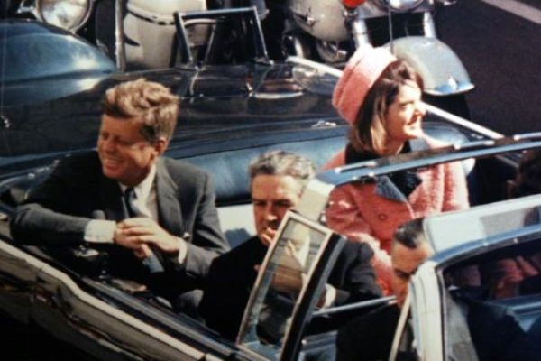
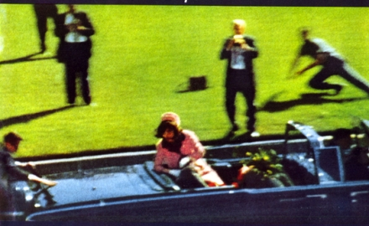

Slide 38
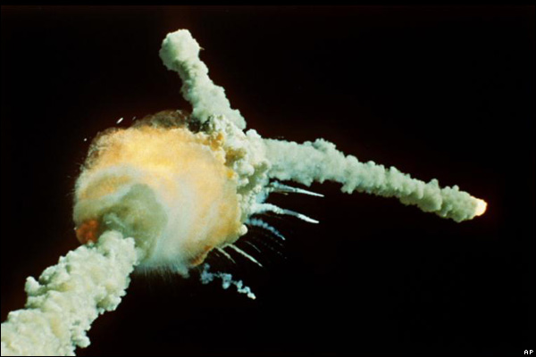
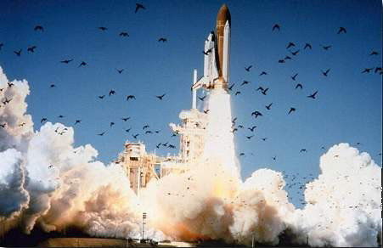

Slide 39
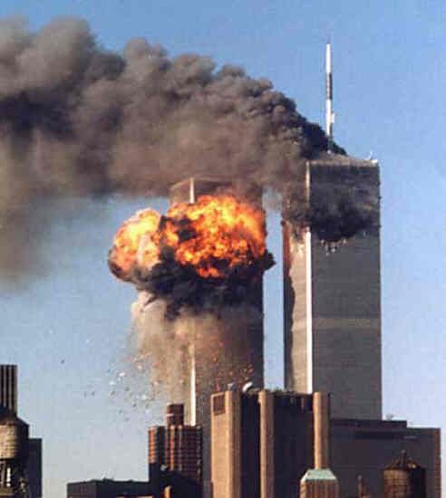

Slide 40
41
24

Slide 41
of the
the
PSALM
CROSS

Slide 42
the PRAYER of ONE in PAIN
REJECTED by GOD
REJECTED by MAN
a DESCRIPTION of DESPERATION

Slide 43
All who see me sneer at me; They separate with the lip, they wag the head, saying, Commit yourself to the Lord; let Him deliver him; let Him rescue him, because He delights in him. –Psalm 22:7-8
And after they had mocked Him, they took His robe off and put His garments on Him, and led Him away to crucify Him. –Matthew 27:31

Slide 44
…they pierced my hands and my feet. –Psalm 22:16
And when they came to the place called The Skull, there they crucified Him. –Luke 23:33

Slide 45
They divided my garments among them, and for my clothing they cast lots. –Psalm 22:18
The soldiers therefore, when they had crucified Jesus, took his other garments and made 4 parts, 1 part to every soldier and also the tunic; now the tunic was seamless, woven in 1 piece. They said; let us not tear it, but cast lots for it, to decide whose it shall be. –John 19:23-24

Slide 46
I can count all my bones. They look, they stare at me. –Psalm 22:17
And the people stood by, looking on
–Luke 23:35

Slide 47
My God, my God, why hast Thou forsaken me? –Psalm 22:1a
And about the 9th hour Jesus cried out with a loud voice, saying, Eli Eli lama sabachthani? That is, my God, my God why hast Thou forsaken me?
–Matthew 27:46

Slide 48
the PRAYER of ONE in PAIN
REJECTED by GOD
REJECTED by MAN
a DESCRIPTION of DESPERATION
a PETITION of PROTECTION

Slide 49
He replied, “You are talking like a foolish woman.
Shall we accept good from God, and not trouble?”
In all this, Job did not sin in what he said.
If he holds back the waters, there is drought;
-Job 2:10; 12:15a

Slide 50
the PRAISE of ONE who is VICTORIOUS
PERSONAL PRAISE
CORPORATE PRAISE
UNIVERSAL PRAISE

Slide 51
Therefore God exalted him to the highest place and gave him the name that is above every name, that at the name of Jesus every knee should bow, in heaven and on earth and under the earth, and every tongue acknowledge that Jesus Christ is Lord, to the glory of God the Father.
-Philippians 2:9-11

Slide 52
PROTECTION
SEEKING
GOD’S
ACCEPTING
GOD’S
PROVISION

Slide 53
LORD MOST HIGH
(Women echo)
From the ends of the earth
From the depths of the sea
From the heights of the heavens
(All)
Your name be praised

Slide 54
(Women echo)
From the hearts of the weak
From the shouts of the strong
From the lips of all people
(All)
This song we raise Lord

Slide 55
Throughout the endless ages
You will be crowned with praises
Lord most high
Exalted in every nation
Sovereign of all creation
Lord most high, be magnified

Slide 56
(Women echo)
From the ends of the earth
From the depths of the sea
From the heights of the heavens
(All)
Your name be praised

Slide 57
(Women echo)
From the hearts of the weak
From the shouts of the strong
From the lips of all people
(All)
This song we raise Lord

Slide 58
Throughout the endless ages
You will be crowned with praises
Lord most high
Exalted in every nation
Sovereign of all creation
Lord most high, be magnified

Slide 59
Throughout the endless ages
You will be crowned with praises
Lord most high
Exalted in every nation
Sovereign of all creation
Lord most high, be magnified
(Repeat)
TEMPLE BIBLE CHURCH Used by Permission #CCLI 78316

